Slide 1
Training Package version 1.0
European project REC-VAW-2016/776919
https://www.work-with-perpetrators.eu/projects/engage
Co-funded by the European Union

Slide 2
Goals of the Roadmap
The goal of the roadmap is to assist the intervention of frontline professionals in health care, social and child protection services, police, and others, coming into contact with male service users who are violent or abusive to their female partners
One of the most common requests from victims is for someone to work with their partner, to help him change and to keep them and their children safe from violence
Working with these men to change their behaviour is a key step towards preventing domestic violence

Slide 3
Who is it for?
The roadmap is designed for frontline professionals who may come into contact with violent or abusive men. There are three ways this may happen:
Men as service users: some men may disclose their abusive behaviour and ask for help, others will present themselves as victims of their (female) partner’s violence, but most will not refer to the abuse
Men as partners of service users: some men insist on accompanying their partners to appointments and/or talk for their partners (they may appear to be caring and protective of their partners and very plausible)
Men as fathers of young service users: in your role you may know children affected by domestic violence, and consequently the perpetrator, with whom you may be in contact in your agency, in his home or at child protection case conferences

Slide 4
Role of a frontline professional when interacting with male perpetrators
As a frontline professional you are not responsible for providing specialist services to help men stop their violence/abuse
Frontline professionals have a responsibility and a central role working in collaboration with other relevant services in an integrated approach to hold the man accountable for his behavior and supporting a safe intervention for victims assuring they receive adequate support
Frontline professionals should have the knowledge, skills and confidence to more effectively identify, address and refer male perpetrators to a perpetrator programme or other specialist services

Slide 5
What is violence?
Behaviours that have a negative impact, both physically and psychologically, on the lives of victims, causing fear and limiting personal freedom
Physical and sexual violence, threats, intimidations, emotional abuse and economical control

Slide 6
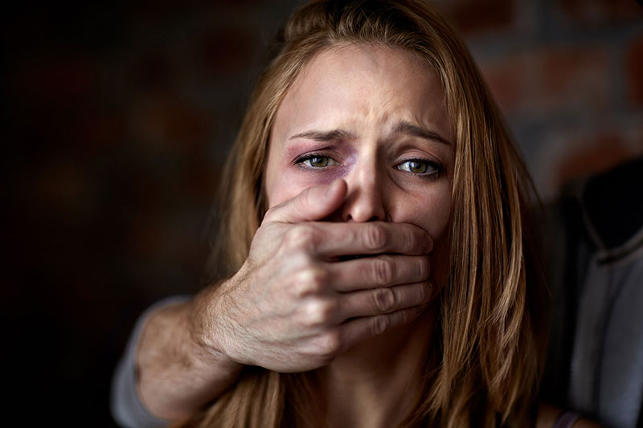
Power and control
Not due to man’s loss of control over his behaviour
Choice made by the man to control his (ex-) partner; variety of tactics to control the partner and exert power over her

Slide 7
Istanbul Convention
For the purpose of this Convention “violence against women” is understood as a violation of human rights and a form of discrimination against women and shall mean all acts of gender-based violence that result in, or are likely to result in, physical, sexual, psychological or economic harm or suffering of women, including threats of such acts, coercion or arbitrary deprivation of liberty, whether occurring in public or in private life - Art. 3 Definitions
First international legally binding document aimed at protecting women and persecuting perpetrators
Requires parties to take the necessary legislative or other measures to set up or support programs aimed at teaching perpetrators of domestic violence to adopt non-violent behavior in interpersonal relationships with a view to preventing further violence and chancing violent behavioral patterns - Art.16

Slide 8
International and national legal references on working with perpetrators of domestic violence
United Nations declaration, Violence against women, 1993
Council of Europe Rec 5, 2005
EU Resolution 4/4/11 on priorities and definitions on violence against women, point 24
France, Italy, Spain, Germany: relevant legal references

Slide 9
Coordinated Community Response
Focusing on the safety and well-being of women and children affected by violence is our priority at every stage of engaging with men
This means at all phases of the work with perpetrators we must also make sure that we focus on specific issues concerning the victims
The system matters: it is important that the system responds to domestic violence in appropriate and coordinated ways

Slide 10
Good practice for victim safety
Make sure all information provided by a victim remains confidential and recognize the effects of violence
Beware of expectations that women may have about perpetrators’ change and impact on their decision to leave
Avoid any form of couple counselling, therapy or mediation
Beware of the manipulation perpetrators often pose on service providers
Make sure the men is held accountable for his violence and avoid any form of victim blaming.
Provide support of specialized support services for victims for risk assessment, empowerment and safety planning

Slide 11
Who commits violence?

Slide 12
Who commits violence?
Video of a man’s recognition of his violent behaviour and its consequences on partner and children
→ Example Italy: https://video.corriere.it/abbiamo-picchiato-nostre-compagne-oggi-siamo-cura-centro-uomini-violenti/51ab39b6-efc5-11e8-bbf1-7b061d972f8e

Slide 13
Ideas and beliefs about men who use violence and abuse
Our ideas and beliefs about domestic violence and about perpetrators can influence our ability to give adequate responses to service users
Some of the most frequent myths on perpetrators are:
Violent men will never change
Men are only violent because of alcohol/substance use or a mental health problem
Perpetrators as good / bad fathers
All perpetrators were abused or witnessed domestic violence as children

Slide 14
What we know about men who use violent behaviour…
No single profile of ’violent men’
No single causal explanation (biological, psychological, relational, cultural, social)
Violent behavior is due to a complex interplay of factors
Traditional models of intervention (psychiatric, psychotherapeutic and psychosocial) are not sufficient to change or stop violent behaviour
Men need to be made accountable for their behaviour through a coordinated community response

Slide 15
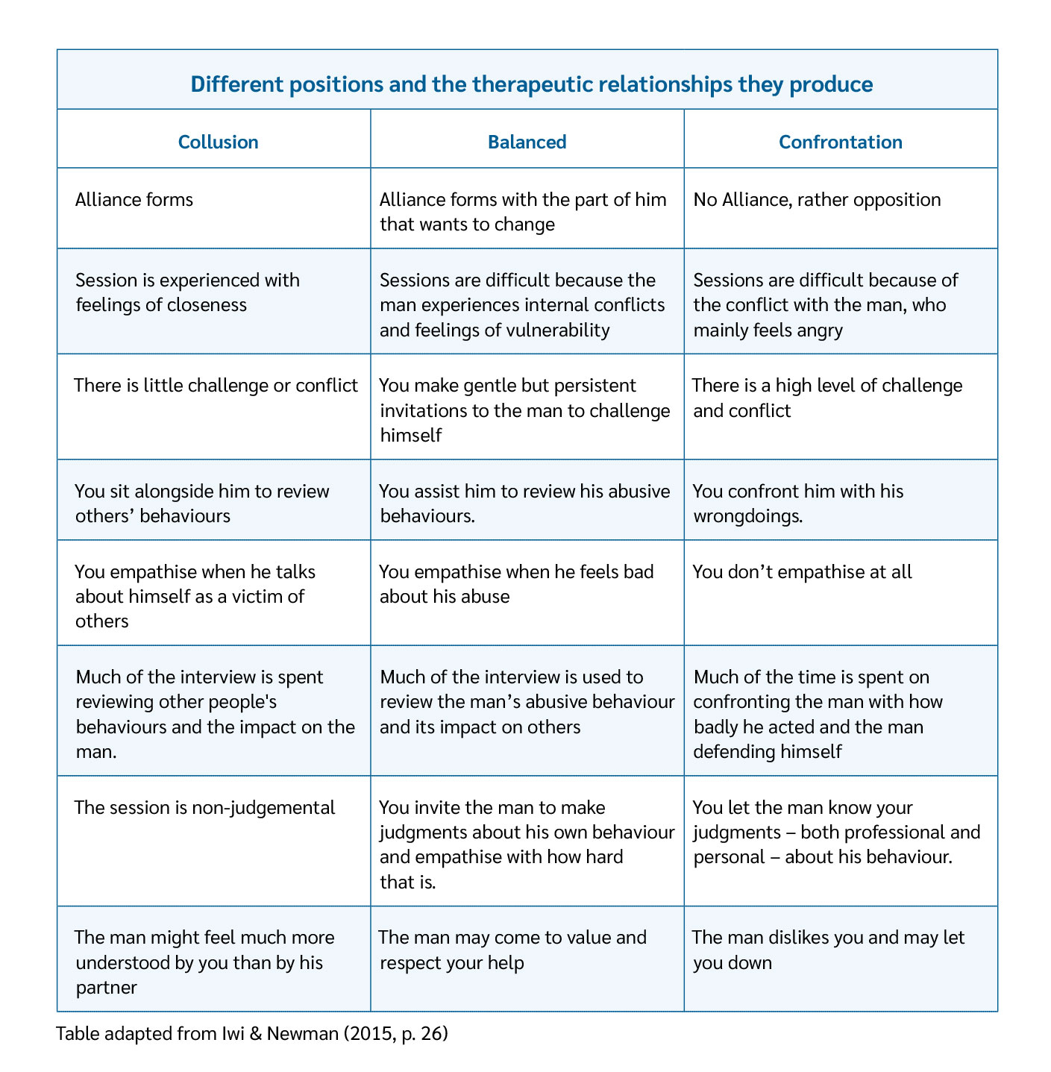

Slide 16
Step 1: Identifying domestic violence and abuse in men – signs and indicators

Slide 17
How does the man present to services?
For health related problems (psychological and / or psychiatric and relational problems, economic difficulties, use of substances, etc.) that mask the problem of domestic violence and abuse
Following a crisis due to an assault or after an ultimatum of the partner, in these cases he will usually blame others for what happened
Accompanying the partner (appointments, medical visits, etc.), appearing efficient and extremely attentive
Because of issues related to child care (e.g.: mental health, measures regarding visitation rights, etc.)

Slide 18
Indicators in the man’s discourse
Talking about relational behaviours that constitute different types of violence or abuse (physical, sexual, emotional, economic)
Referring excessively jealous behaviour and control over the partner «who always has to tell him where she is»
Sexist or misogynistic attitudes or comments (about the partner or women in general)
Euphemisms that could indicate any of the above (e.g., “big fight” or “strong argument”, etc.)

Slide 19
Indicators in the man’s or partner’s behaviour
He always accompanies the partner, even during routine visits and insists on being in the sessions (and she is disappointed or in a hurry to finish)
He speaks for her, interrupts or corrects her, doesn’t let her talk, discredits or devalues her, tries to make decisions for her
He justifies or minimizes his partner’s injuries or psychological states, which may be due to situations of violence
He blames her for his problems
He shows difficulties in managing anxiety and stress; he has mood swings and/or raises his voice
He shows two apparently contrasting attitudes: being silent, defensive, refusing to answer questions or being overly talkative and sometimes foul, overly compliant, smiling too much, being too present, especially during the interview with the partner

Slide 20
Indicators in the man’s or partner’s behaviour (contd.)
He shows a threatening non-verbal attitude or gesticulation invading the woman's space
He is violent or abusive towards his partner in the session or waiting room
He tries to manipulate or control the partner, professional or situation (e.g. the type of questions or the duration of the interview)
He disqualifies female frontline professionals as women, or shows demeaning and aggressive attitude towards the female professional
The partner lowers her gaze, is silent or puts herself in a submissive attitude in the presence of the man
Differences in attitude of the woman between sessions with the man and sessions with her only
They are conflictual and accuse each other or they give an exasperate sense of perfection of the relationship, denying any conflict

Slide 21
Case Study – First exercise: Step 1
Read through the case that you were assigned
Please discuss with a partner which indicators you have found that point to the fact that the man you are reading about is a perpetrator
Please circle all indicators you have found

Slide 22
Step 2: Asking men about domestic violence and abuse

Slide 23
Asking men about domestic violence and abuse
Create an environment of privacy and safety that facilitates disclosure and be clear about the conditions of confidentiality that apply
Many men remember being asked about the violence as an important factor to opening up and sharing information about they had never talked about before
Do not address the issue of domestic violence and abuse in the presence of the partner
Explore the violence with progressive questions from generic to more specific and focused

Slide 24
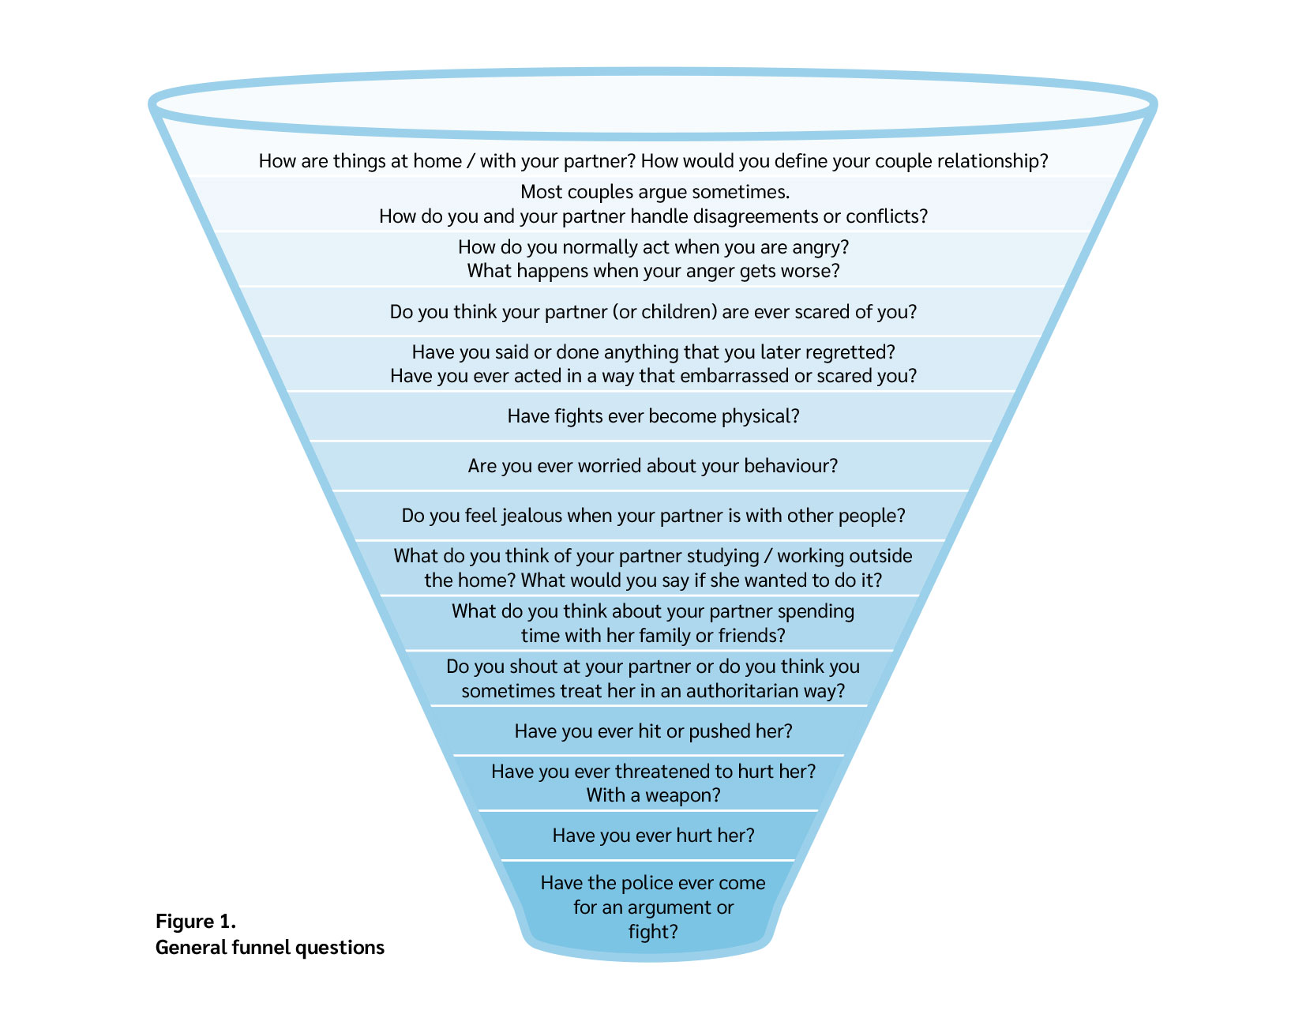
ENGAGE funnel questions: general

Slide 25
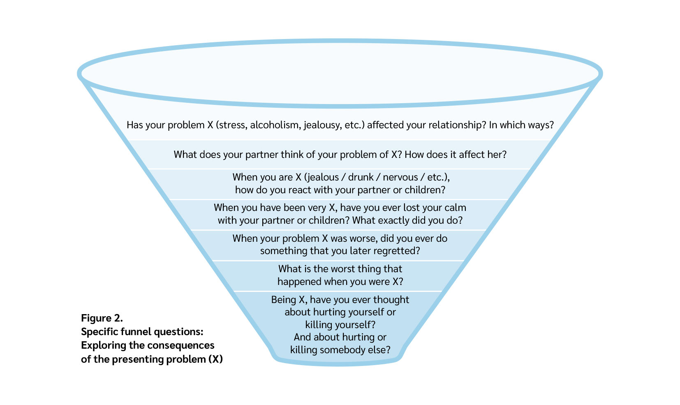
ENGAGE funnel questions: specific

Slide 26
Exploring violence
If there are indicators of a high, immediate risk for considerable harm to the (ex-) partner and/or children (such as threats to hurt or kill them or to kill himself), you will have to take any necessary measures to protect the victims, including reporting to the relevant authorities / police forces
Checklists can be used for areas of investigation: physical, psychological, sexual, economic violence. Each area can be explored by investigating in detail the first episode, the last episode, an episode considered more serious
While alcohol and/or substance use is neither an excuse nor a cause of domestic violence the two problems often occur together and referring some abusive men to substance abuse treatment is appropriate and might reduce their risk of using violence

Slide 27
Useful strategies
Pulling the thread - to explore with more detail the incidents of conflict and possible violence narrated superficially by the man. Using a credulous “Colombo attitude” of genuine interest and curiosity, we can ask for gaps and apparent inconsistencies or contradictions in the narration without a direct confrontation
Gambit - Accepting minimizations: allows us to explore the incidents of violence and the man’s experience and intentions more richly by not creating a defensive reaction. “When you say ‘big fight’, what are you referring to?”, “What exactly happened / did you do?” “What do you think your partner felt?”
Perspectives - To inquire about the perspectives of significant others (partner, children, parents, siblings, friends, etc.) on their acts of violence, sometimes allows men to contact (from a certain empathy) with the consequences their violence has caused for others and initiate a process of accountability and motivation to change

Slide 28
Different versions of the story
2 different and even conflicting versions of the story
Victim’s story does not match up with the perpetrator’s story
→It is not about identifying the truth about what happened
→Man may be in denial about his behaviour or minimise his behavior
Focus is on engaging the man to reflect on his behavior, to seek assistance from specialized perpertrator programmes.

Slide 29
Fears about engaging with men
Fear of making a situation worse for the victim
Fear that the man could react violently towards the professional
→While it is understandable to have such fears as a frontline professional, not engaging with a man allows the cycle of violence to continue
When starting the conversation with a man do not indicate that the victim may have instructed you to ask about violence, as this can place the victim at risk after the conversation. State it is 'routine' to ask.
Speak respectfully, without judging, following the 4 steps of the Roadmap

Slide 30
Case Study – Second exercise: Step 2
Explore violence through the described funnel method (role-play)

Slide 31
Step 3: Motivating perpetrators for referral

Slide 32
Motivating perpetrators for referral
The main goal of the third step is motivating perpetrators to take responsibility for their violence and for initiating a change process to stop it
Many men may be ambivalent or even resistant about initiating a process of change and some motivational work might be needed to prepare a successful referral
Rather than convincing a man to change, it is more helpful to accompany him to identify the reasons for not using violence and what helps change in the desired direction (see Jenkins, 1990, 2006 - Invitations to responsibility; Miller and Rollnick 1991 – Motivational Interview)

Slide 33
Invitations to responsibility approach (Jenkins, 1990, 2006)
Examples of questions within an invitations to responsibility approach are:
What kind of a father did you hope to be / would you like to be?
How would you like your kids to see you / think of you in 10 or 20 years?
Have you kids seen you act violently or abusively? How do you think it affects them?
Do you think your children respect you or fear you?
How might your kids benefit if you did some work on your behaviour?
How do you think your relationship with your kids might change if they weren’t feeling scared of you?
What could become possible in your life if you didn’t use violence when you felt upset?
What type of father would you like to become, or be more of the time? What would it mean to you if you were that Dad, or that Dad more of the time? What do you do that gets in the way of this?

Slide 34
Case Study – Third Exercise: Step 3
Review and discuss the case briefly in the big group.
One training participant should role play as the perpetrator, and in turn everyone asks a question to help motivate the man.
At the end of the exercise there is a big group discussion. (Perpetrator can also be played by trainer)

Slide 35
Step 4: Referring men to perpetrator programmes, coordinated multi-agency response

Slide 36
Referring men to a perpetrator programme
If you have detected and addressed domestic violence in a service user and have been able to co-create sufficient acknowledgement and motivation for referral, you should refer the man to a perpetrator programme
A structured perpetrator programme usually entails an individual intake and assessment phase, group (or individual) intervention and, ideally a follow-up phase to see whether objectives are achieved and maintained
Perpetrator programmes should fulfill different quality standards, including to pro-actively contact the (ex-) partners of the men they work with to make sure they receive the information and support they need for them and their children to be safe

Slide 37
Good practices for referrals
Where no structured perpetrator programmes are available, individual counselling clearly aimed at stopping the use of violence might be an alternative if this includes risk assessment and management within a victim/survivor safety focused approach
It is important to prepare the referral well and to inform the man about why he is being referred, what the benefits are for him and others, what his rights and responsibilities are in relation to the referral and what to expect from it
Agree about the mechanism of feedback and coordination with the specialised service you refer the man to while you keep working with him and about how you can support his participation in the programme
Do not refer a man who uses domestic violence and abuse to anger management courses or programmes, couples counselling or therapy, mediation and family therapy

Slide 38
Case Study –Fourth Exercise: Step 4
In small groups, make a referral plan for Richard to a specialized service.
Discussion in the big group.

Slide 39
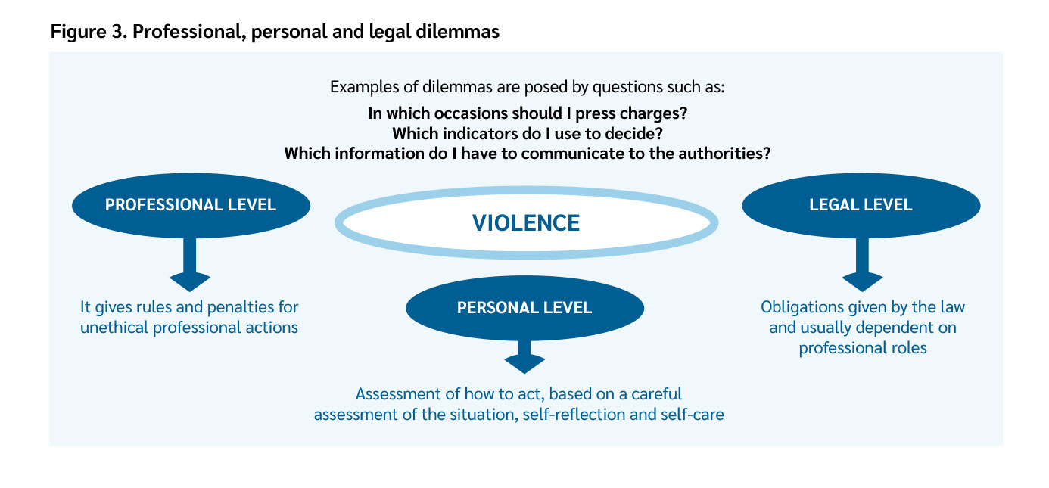
Professional, personal and legal dilemmas

Slide 40
In a nutshell
Make sure that the victims/survivors receive adequate support and safety planning. Have the safety and well-being of women and children as your priority at any step in the process
Be aware of any signs or indicators of domestic violence and abuse in male service users’ discourse and behaviour
Respond to any (even indirect) disclosure and ask men about domestic violence and abuse
Be clear that violence and abuse are unacceptable and that they are a choice
Be aware and convey to the man that domestic abuse includes a range of different behaviours, not only physical violence
Be aware of your feelings about the man’s behaviour and don’t let them interfere with your provision of a supportive service: distinguish the behaviour from the person and don’t be judgemental
* Adapted from: Guidelines for Working with Men Perpetrating Domestic Violence (Respect Phoneline, 2013)

Slide 41
In a nutshell
Be empathic and understanding but don’t collude with the man: be aware of the mechanisms of minimization, denial and victim-blaming and don’t give in to possible manipulations
Be aware of the barriers to him acknowledging his abuse and seeking help (such as shame, fear of child protection) and recognise any accountability shown by him
Be positive about the possibility of change and explore the man’s own motivations for it (including the costs of continued violence to himself and the effects on children)
Establish a referral pathway to a perpetrator programme (or similar specialised service) in your area and refer the man
If you are in contact with both partners, try not to see them together and only discuss domestic abuse in separate sessions
* Adapted from: Guidelines for Working with Men Perpetrating Domestic Violence (Respect Phoneline, 2013)

Slide 42
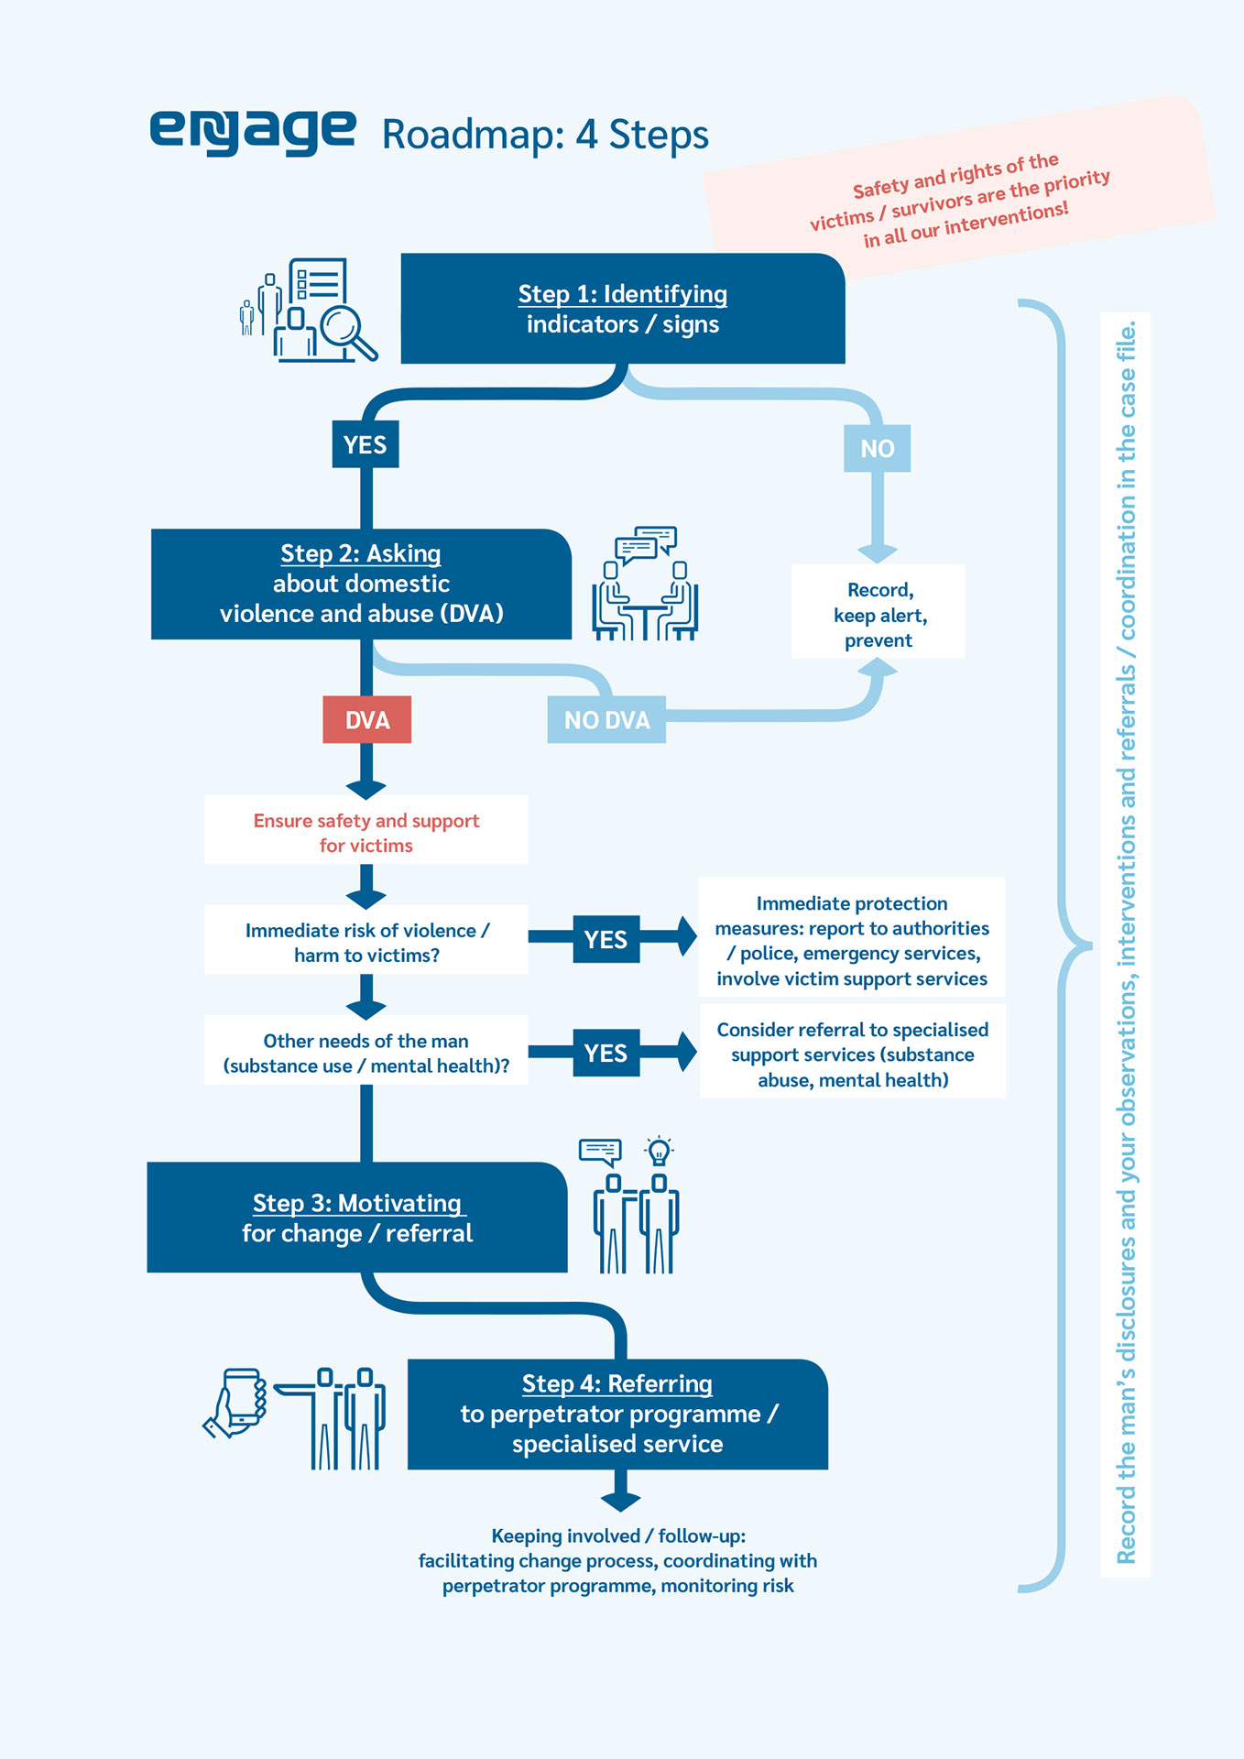
ENGAGE Roadmap

Slide 43
Thank you very much for your attention!
This presentation has been produced with the financial support of the Rights, Equality and Citizenship Programme of the European Union for the project REC-VAW-AG-2016/776919. The contents of this publication are the sole responsibility of the project partners and can in no way be taken to reflect the views of the European Commission.
For more information: https://www.work-with-perpetrators.eu/projects/engage
Photos: istock.com

